Slide 1
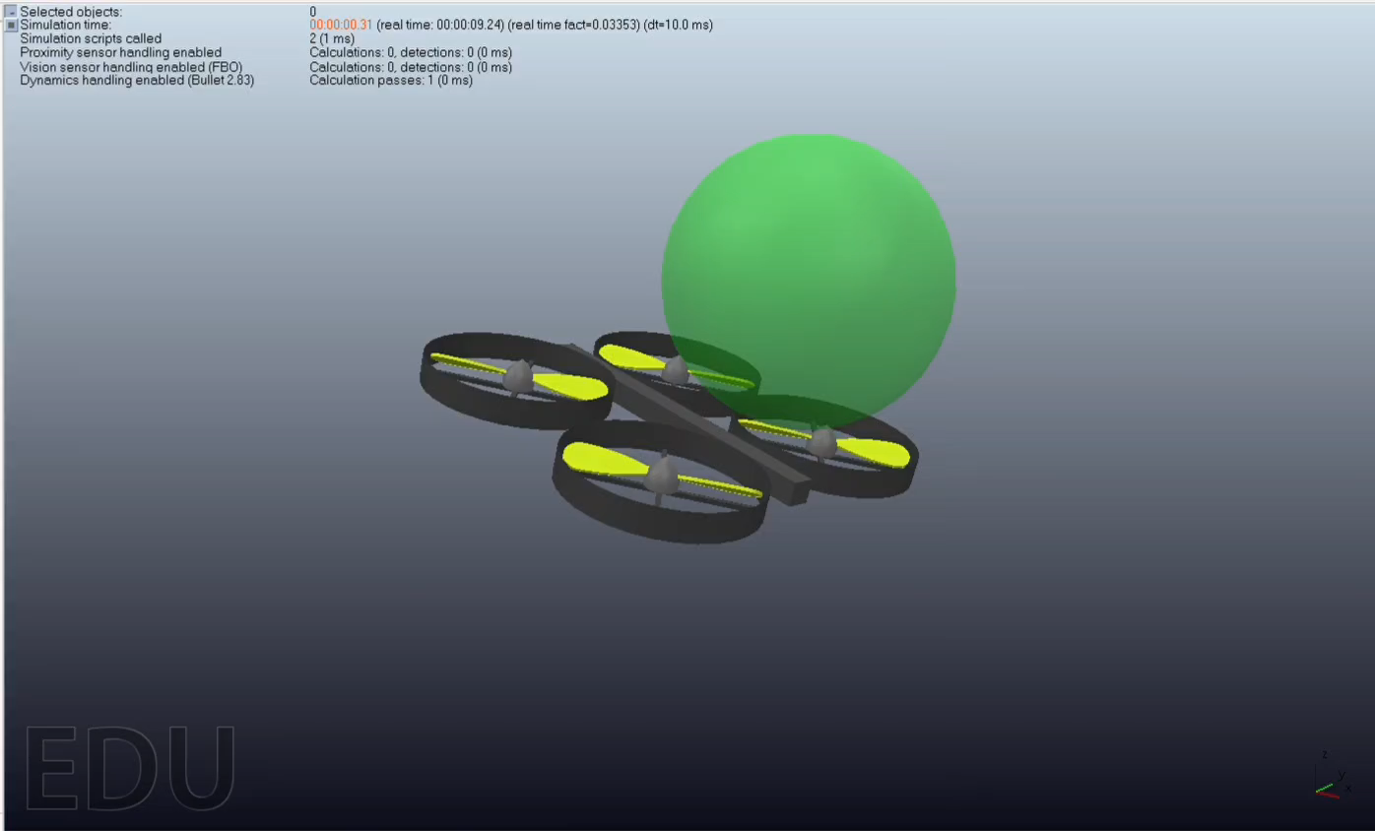
REINFORCEMENT LEARNING AND COPPELIASIM: TEACHING A DRONE TO FLY!
Nir Manor, Gil Gur-Arieh
ME038785

Slide 2
INTRODUCTION
OUR OBJECTIVE
Problem Statement: Teaching a quadcopter drone to stabilize itself and fly towards a target in 3D, without using any control models or error calculations.
Scenario: Drone is simulated in a CoppeliaSim scene (environment) and controlled through a learning agent, utilizing python (CoppeliaSim API, gym environment, stable-baselines agents).
Project Goal: A trained agent which controls the CoppeliaSim drone and flies it towards the goal.

Slide 3
BACKGROUND

Slide 4
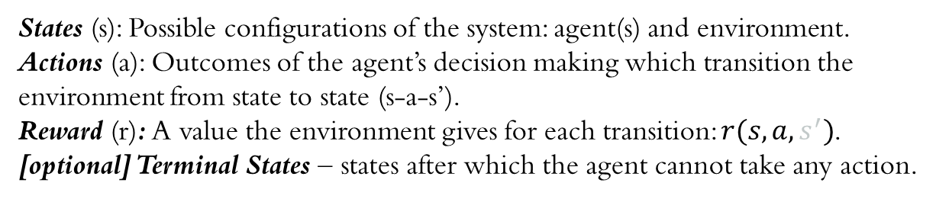
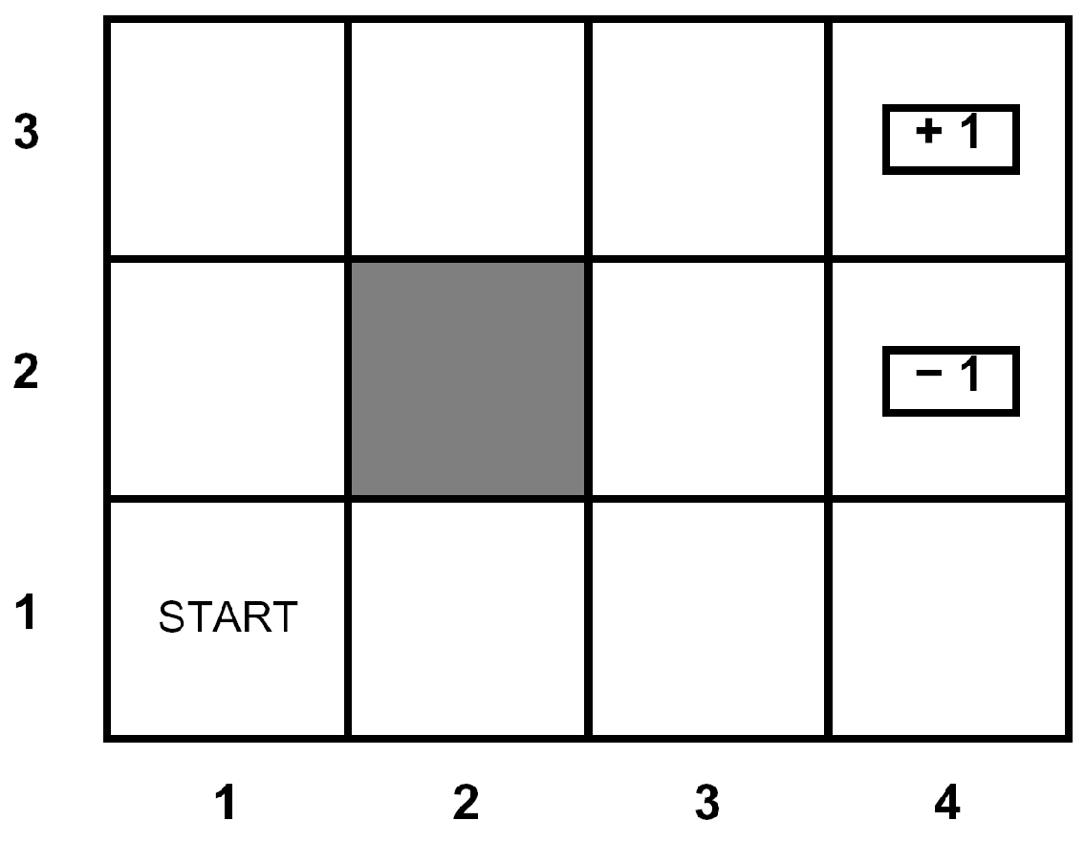





WHAT IS RL?
BACKGROUND - REINFORCEMENT LEARNING BASICS
In a Reinforcement Learning problem, an agent can take actions in a dynamic environment and receive rewards, which help the agent improve its behavior.
Environment
action (a)
Agent
state (s)
AN RL PROBLEM IS DEFINED BY:
reward (r)
new state (s’)
RL OUTCOMES

Slide 5
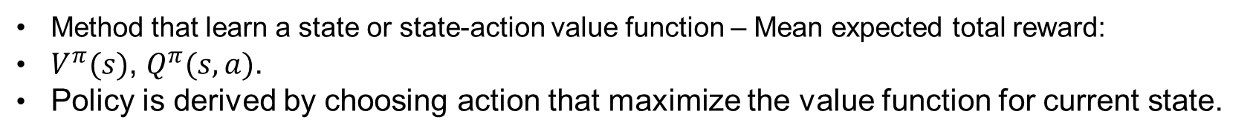
POLICY BASED METHODS
POLICY VS. VALUE-BASED METHODS
VALUE BASED METHODS
ACTOR-CRITIC METHODS
Methods that employ both a parametric policy (actor) and a parameterized value function (critic).
Value function parameters are updated after rollout, policy parameters are updated using the value function.

Slide 6
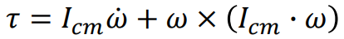
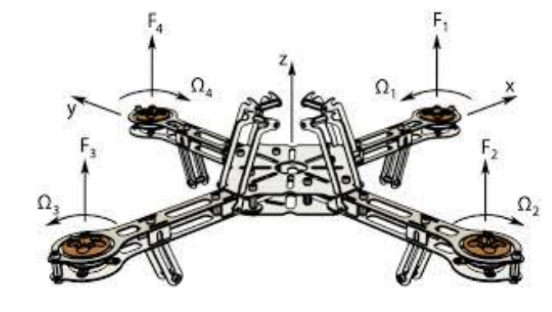
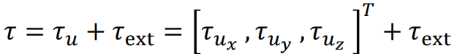
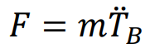
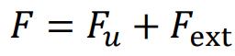
rotational dynamics
translational dynamic
BACKGROUND - DRONE DYNAMICS
.

Slide 7
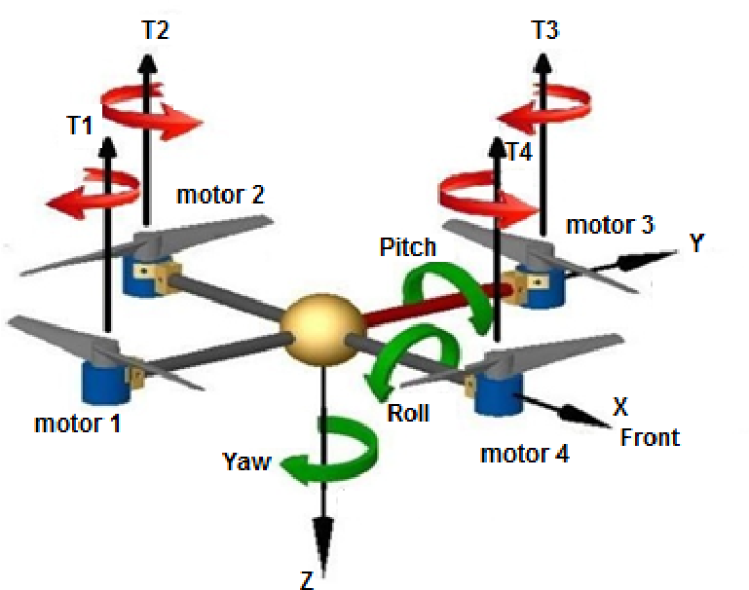
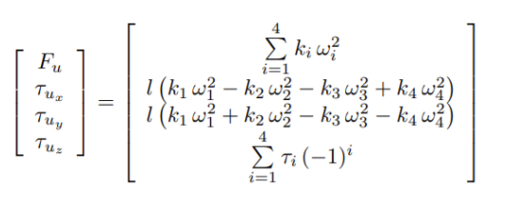
BACKGROUND - DRONE Dynamics

Slide 8
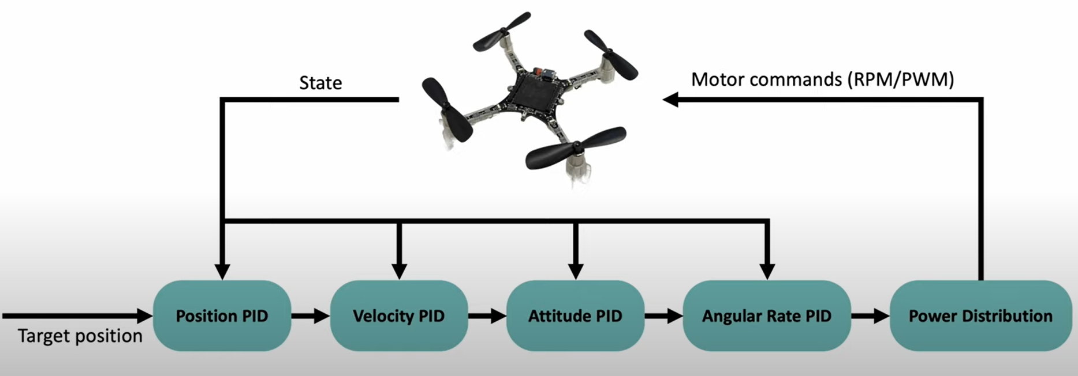
BACKGROUND - CLASSIC PID CONTROL

Slide 9
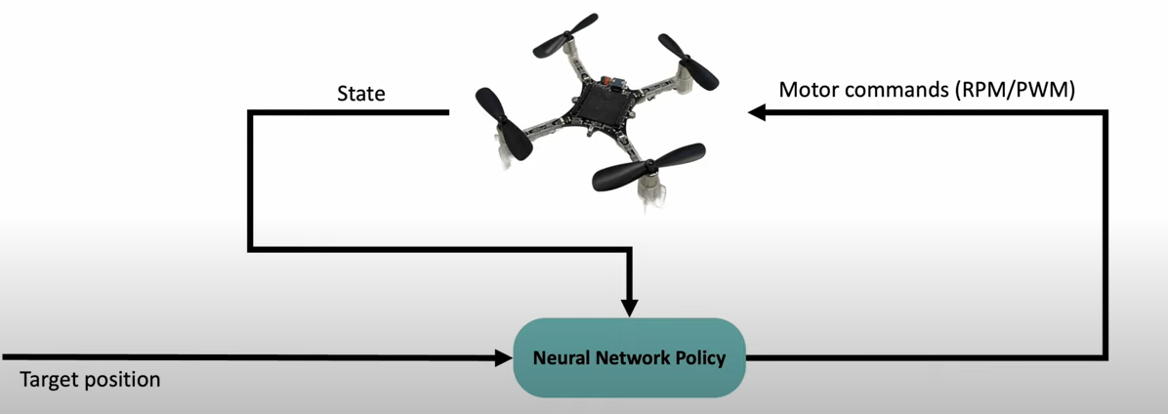
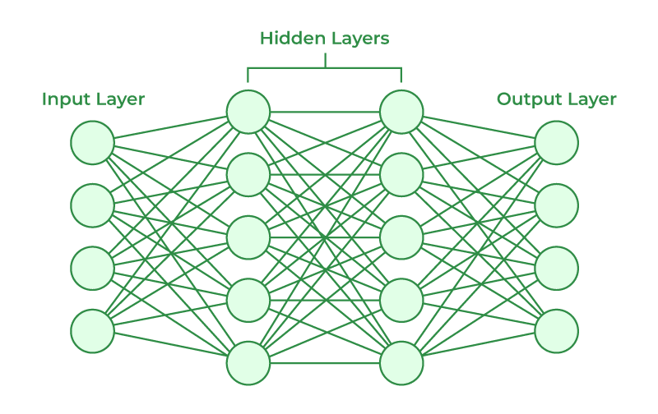
BACKGROUND - DEEP RL CONTROL
Notes:
?

Slide 10
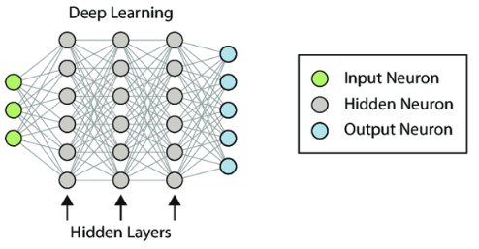
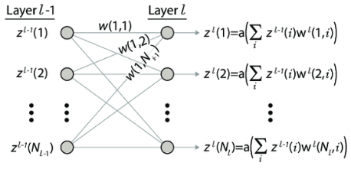

BACKGROUDN - DEEP RL ACTIVATION FUNCTION
Policy (actor) network: From [states x actions] to [0,1]
Value (critic) network: from [states x actions] to Advantage-values
Notes:
?

Slide 11
Project Overview

Slide 12
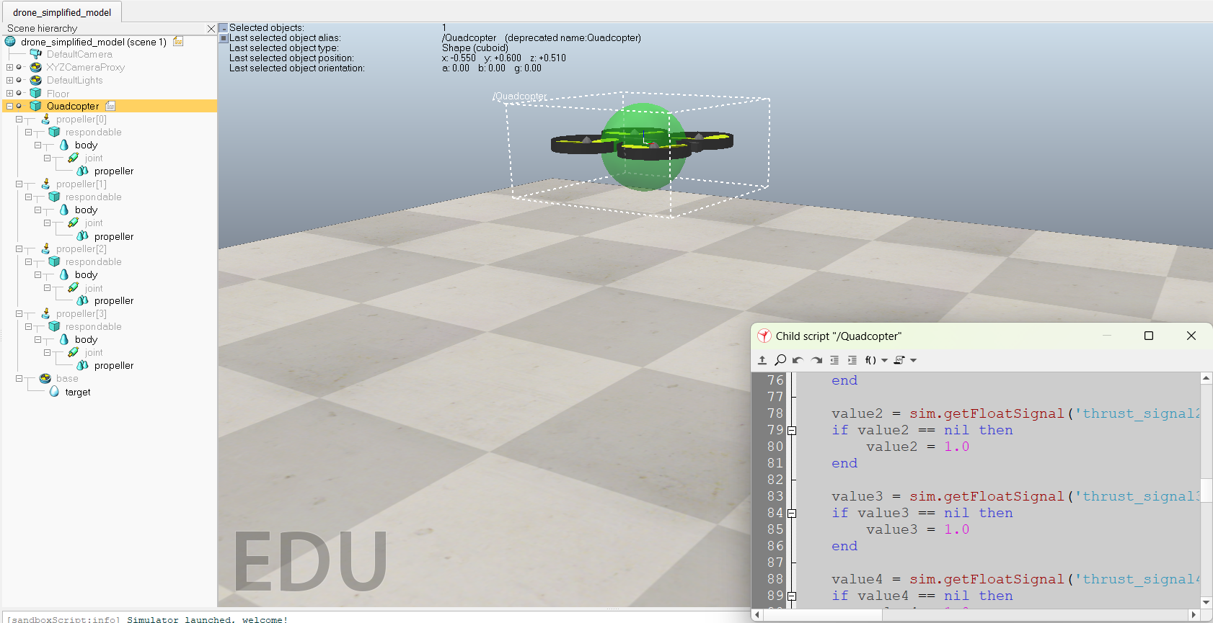
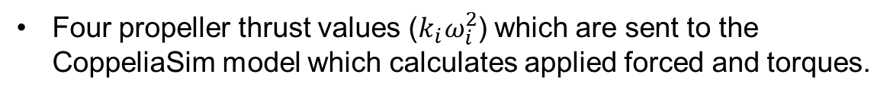
STATES (S)
OUR RL FRAMEWORK (MDP)
A 1x16 vector which consists:
Drone orientation (in quaternion form)
Drone position (x,y,z)
Drone linear and angular velocities
Target position (x,y,z)
Terminal states:
Drone crashes to the floor
Drone angle too high
Drone too far from target
ACTIONS (A)
REWARD (R)

Slide 13
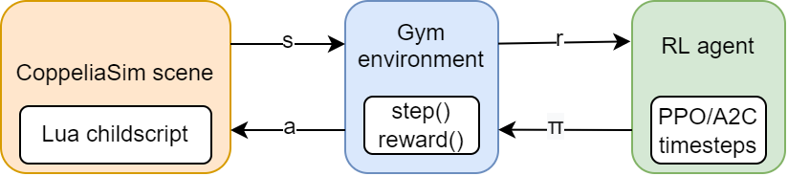
COPPELIASIM SCENE
PROJECT CODE STRUCTURE
Includes the built-in drone robot, with its control code removed. 4 thrust values are taken as a signal from API and sent into the “handle propeller” function.
GYM ENVIRONMENT- PYTHON
reset() method randomizes positions and starts simulation.
step(action) sends an action to CoppeliaSim, gets new state and calculates reward.
Termination and truncation conditions calculated at each step.
REINFORCEMENT LEARNING AGENT
Chooses a policy for each episode and updates policy with rewards collected.
A2C agent: policy and value network have 2 layers of 128 neurons.

Slide 14
Major Challenges

Slide 15
SYNCHRONIZATION CHALLENGES IN PYTHON AND COPPELIASIM INTEGRATION
MAJOR CHALLENGES - SYNCHRONIZATION
Perfect synchronization between Python and CoppeliaSim is crucial for accurate reinforcement learning.
Key challenges faced:
Ensuring synchronization of simulation steps.
Maintaining state consistency to avoid instability
Proper handling of simulation resets
Ensuring correct execution timing of commands.

Slide 16
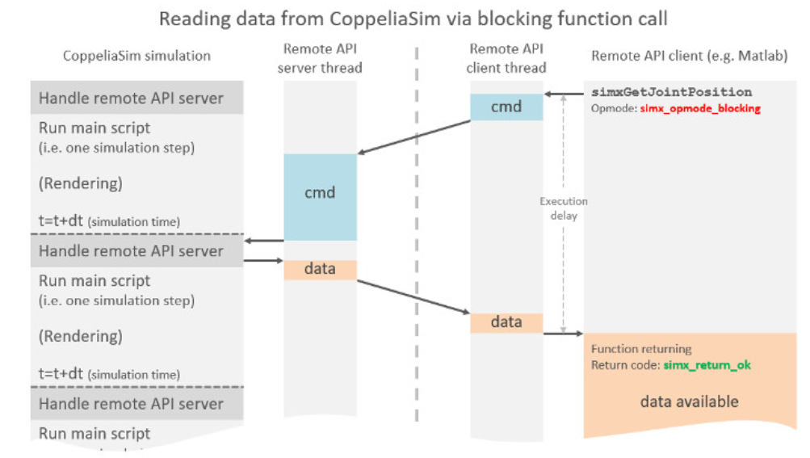
SOLUTIONS - SIGNAL HANDLING
MAJOR CHALLENGES - SYNCHRONIZATION
Operation Modes:
simx_opmode_blocking: Used for blocking calls to ensure accurate state retrieval. It waits for the command to be executed and the result to be returned before proceeding. This mode ensures that the state information received is up-to-date.

Slide 17
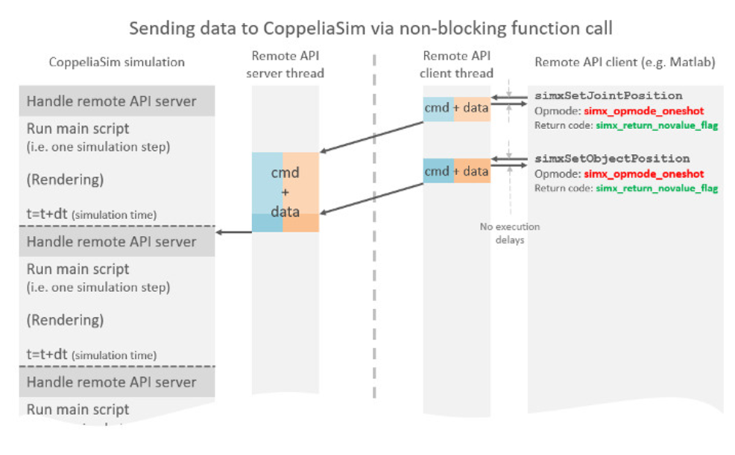
SOLUTIONS - SIGNAL HANDLING
MAJOR CHALLENGES - SYNCHRONIZATION
Operation Modes:
simx_opmode_oneshot: Used for non-blocking updates where immediate execution is required without waiting for a response. It is suitable for setting multiple thrust signals in quick succession.

Slide 18
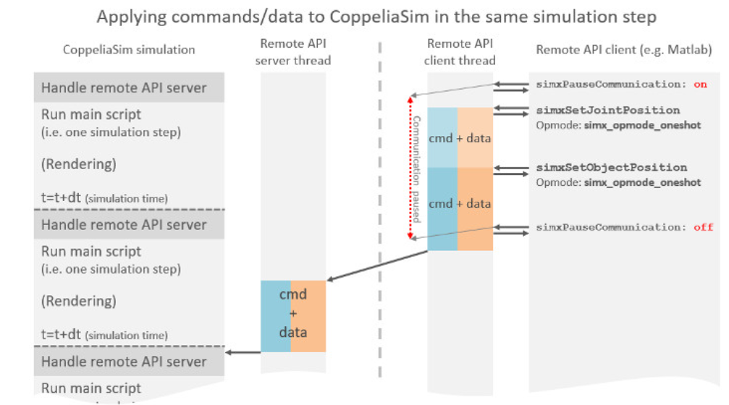
SOLUTIONS - SIGNAL HANDLING
MAJOR CHALLENGES - SYNCHRONIZATION
Pause and Resume Communication:Used “simxPauseCommunication” to ensure that multiple thrust signals are sent in one communication packet, reducing the risk of partial updates.
sim.simxPauseCommunication(self.client_ID, True)
sim.simxSetFloatSignal(self.client_ID, ’thrust_signal1’, thrust[0], sim.simx_opmode
sim.simxSetFloatSignal(self.client_ID, ’thrust_signal2’, thrust[1], sim.simx_opmode
sim.simxSetFloatSignal(self.client_ID, ’thrust_signal3’, thrust[2], sim.simx_opmode
sim.simxSetFloatSignal(self.client_ID, ’thrust_signal4’, thrust[3], sim.simx_opmode
sim.simxPauseCommunication(self.client_ID, False)

Slide 19
SOLUTIONS - SYNCHRONIZATION
MAJOR CHALLENGES - SYNCHRONIZATION
Synchronous Mode:
Enabled CoppeliaSim’s synchronous mode to ensure the simulation only progresses when triggered by the Python code.
sim.simxSynchronous(self.client_ID, True)
sim.simxStartSimulation(self.client_ID, sim.simx_opmode_oneshot)

Slide 20
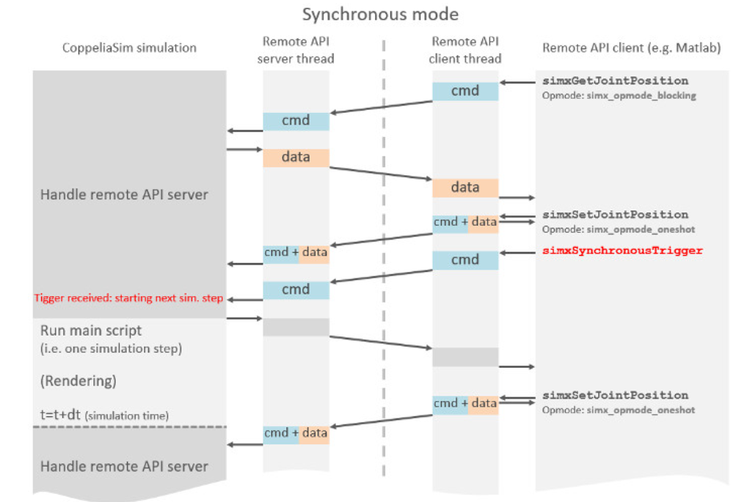
SOLUTIONS - SYNCHRONIZATION
MAJOR CHALLENGES - SYNCHRONIZATION
Synchronous Trigger:
Used sim.simxSynchronousTrigger in each step to manually advance the simulation by one step, ensuring precise control over the simulation timing.
sim.simxSynchronousTrigger(self.client_ID)
When calling simxSynchronousTrigger, the next simulation step will start computing. This doesn't mean that when the function call returns, the next simulation step will have finished computing.

Slide 21
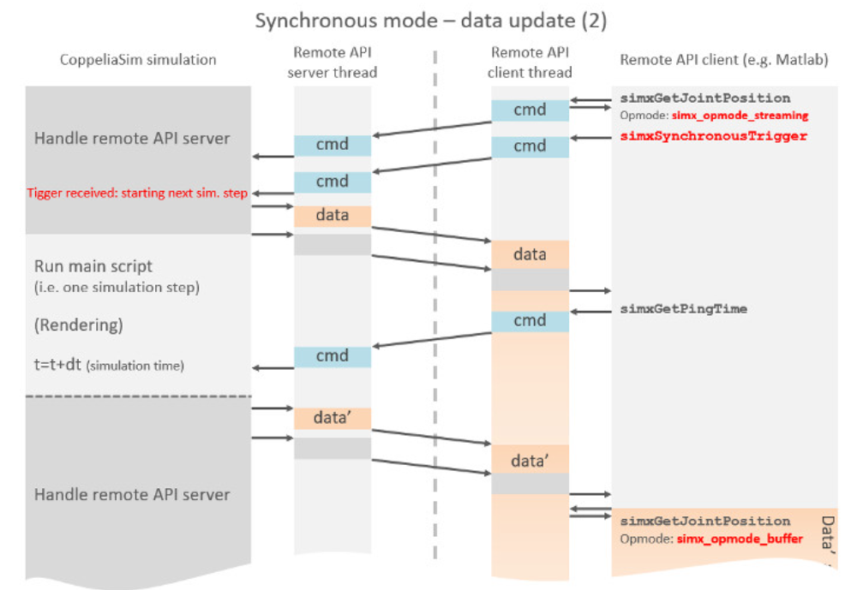
SOLUTIONS - SYNCHRONIZATION
MAJOR CHALLENGES - SYNCHRONIZATION
Synchronous Ping:
Used sim.simxGetPingTime(self.client_ID) to call a function in a blocking fashion directly after calling simxSynchronousTrigger)
After this call, the first simulation step is finished (Blocking function call) and we can safely read all streamed values

Slide 22
SOLUTIONS - RESET
MAJOR CHALLENGES - SYNCHRONIZATION
Stop the simulation:
sim.simxStopSimulation(self.drone_sim_model.client_ID, sim.simx_opmode_blocking)
sim.simxGetPingTime(self.drone_sim_model.client_ID)
time.sleep(0.01)
Re-enable synchronization:
sim.simxSynchronous(self.client_ID, True)
Set initial position orientation and target
Start the simulation again
sim.simxStartSimulation(self.drone_sim_model.client_ID, sim.simx_opmode_oneshot)
sim.simxSynchronousTrigger(self.client_ID)

Slide 23
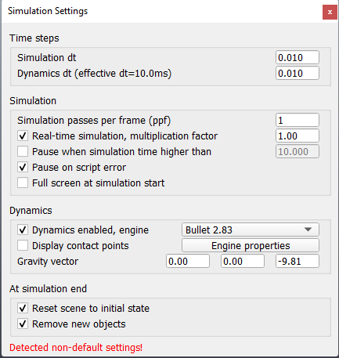
SOLUTIONS - COPPELIASIM SIMULATION
MAJOR CHALLENGES - SYNCHRONIZATION
Adjusting Simulation Parameters
To ensure the simulation runs correctly and in sync with the RL process, we adjusted the Simulation Time Step and Dynamics Time Step in CoppeliaSim to be equal to each other, setting both to 5/10 ms.

Slide 24
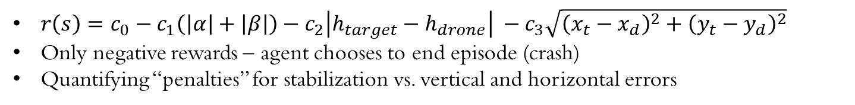
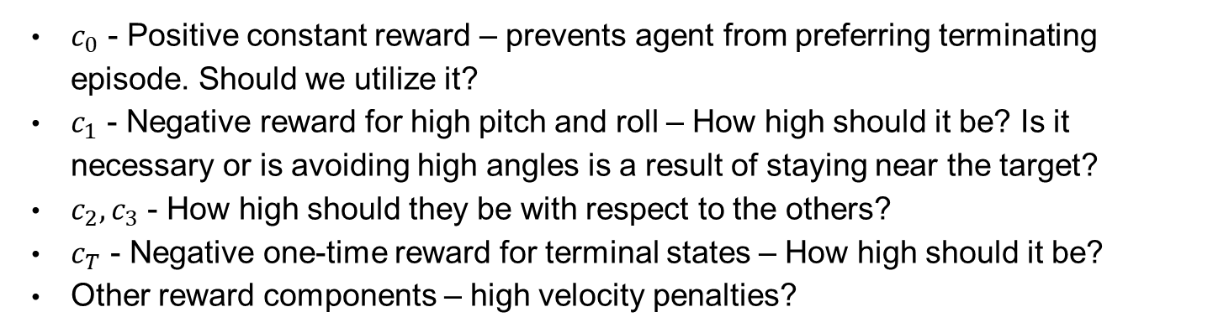
MAJOR CHALLENGES – Reward Shaping
Reward:
Reward components:

Slide 25
MAJOR CHALLENGES – RL choices
Algoirthm: Actor-Critic methods (A2C) or Policy methods (PPO)
Neural Network: Depth (no. of layers) and width (no. of neurons per layer)
Timesteps: How long is enough to converge? (100,000? 1 Million?)
Initial states: fixed or randomized? What variance?
Limited resources: 3 timesteps per second (100,000 timesteps ≈ 9 hours)

Slide 26
Results

Slide 27
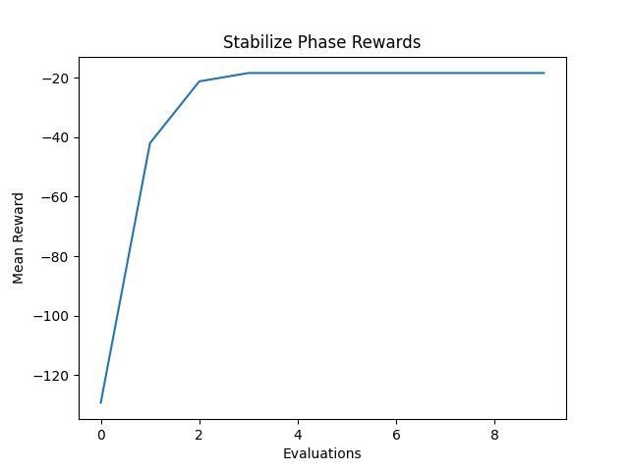
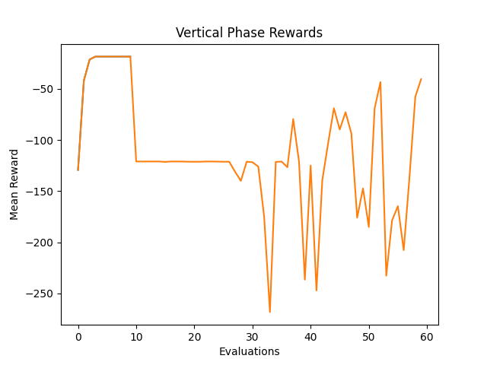
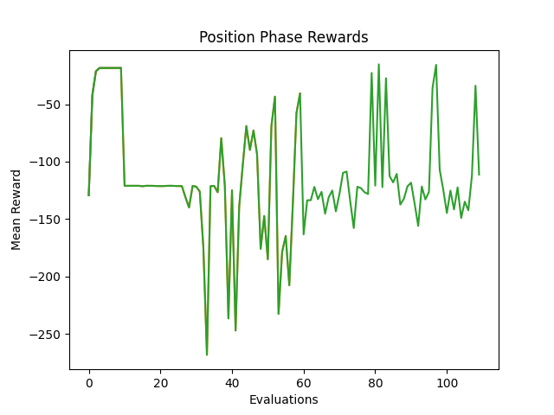
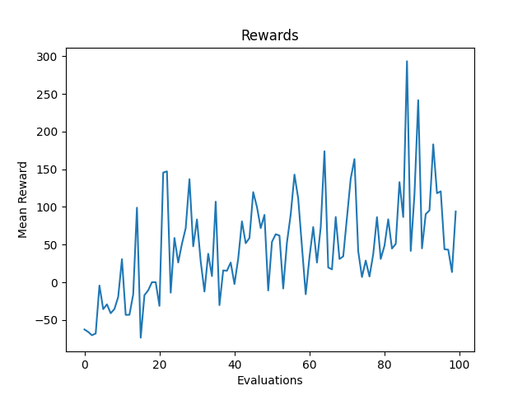
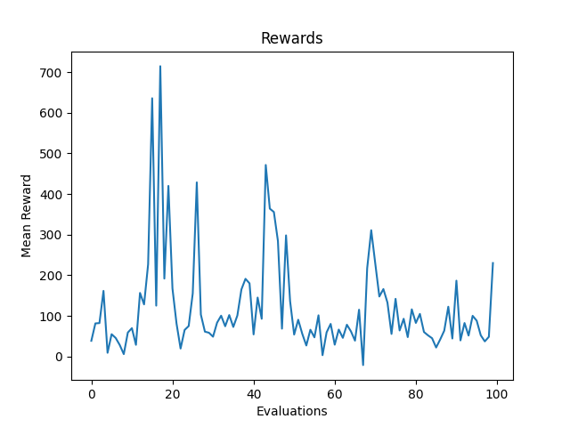
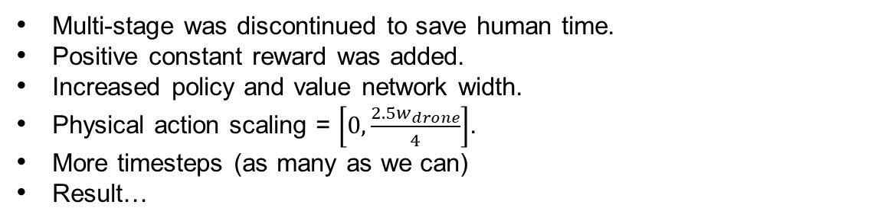
Multi-stage learning
THE LEARNING PROCESS
Drone and target at same position and drone is upright.
First – only stabilization reward (penalty for pitch and roll only).
Second – add vertical distance reward.
Third – add horizontal distance reward.
Result policy: drop slowly enough to not crash before termination.
Improvements
Multi-stage was discontinued to save human time.
Positive constant reward was added.
Increased policy and value network width.
Physical action scaling = $\left[0,\frac{{2.5w}_{drone}}{4}\right]$.
More timesteps (as many as we can)
Result…

Slide 28
Thank you! Questions?

